Slide 1
MODULE V

Slide 2
Traditional Applications
Two of the most popular traditional applications are
  The World Wide Web (www)
  Email.
Both of these applications use the request/reply method. i.e., users send requests to servers, which then respond accordingly.

Slide 3
Traditional Applications
It is important to distinguish between application programs and application protocols.
For example, the HyperText Transport Protocol (HTTP) is an application protocol that is used to retrieve Web pages from remote servers.
There can be many different application programs—that is, Web clients like Internet Explorer, Chrome, Firefox, etc that provide users with a different look and feel, but all of them use the same HTTP protocol to communicate with Web servers over the Internet.

Slide 4
Traditional Applications
Two very widely-used, standardized application protocols:
  SMTP: Simple Mail Transfer Protocol is used to exchange electronic mail.
  HTTP: HyperText Transport Protocol is used to communicate between Web browsers and Web servers.

Slide 5
Traditional Applications
Electronic Mail (SMTP, MIME, IMAP)
  Email is one of the oldest network applications
  It is important
  (1) to distinguish the user interface (i.e., your mail reader) from the underlying message transfer protocols (such as SMTP or IMAP), and
  (2) to distinguish between this transfer protocol and a companion protocol (RFC 822 and MIME) that defines the format of the messages being exchanged

Slide 6
Traditional Applications
Electronic Mail (SMTP, MIME, IMAP)
  Message Format
    RFC 822 defines messages to have two parts: a header and a body. Both parts are represented in ASCII text.
    Originally, the body was assumed to be simple text and allow the message body to carry all types of data.
    This data is represented as ASCII text, because it may be an encoded version of a JPEG image, which is not readable by human users.
    The message header is a series of <CRLF>terminated lines. (<CRLF> stands for carriage-return+ line-feed, which are a pair of ASCII control characters often used to indicate the end of a line of text.)

Slide 7
Traditional Applications
Electronic Mail (SMTP, MIME, IMAP)
  Message Format
    The header is separated from the message body by a blank line. Each header line contains a type and value separated by a colon.
    Many of these header lines are familiar to users since they are asked to fill them out when they compose an email message.
    RFC 822 was extended to allow email messages to carry many different types of data such as audio, video, images, PDF documents, and so on.

Slide 8
Traditional Applications
Electronic Mail (SMTP, MIME, IMAP)
  Message Format
    MIME consists of three basic pieces.
      The first piece is a collection of header lines.
        These header lines describe the data being carried in the message body. They include
        MIME-Version: the version of MIME being used.
        Content-Description: a human-readable description of what’s in the message, analogous to the Subject: line.
        Content-Type: the type of data contained in the message.
        Content-Transfer- Encoding how the data in the message body is encoded.
      The second piece is definitions for a set of content types and subtypes. For example, MIME defines two different still image types, denoted image/gif and image/jpeg, each with the obvious meaning.
      The third piece is a way to encode the various data types so they can be attached in an ASCII email message.

Slide 9
Traditional Applications
Electronic Mail (SMTP, MIME, IMAP)
  Message Transfer
    SMTP protocol is used to transfer messages from one host to another.
    To place SMTP in the right context, we need to identify the key players.

Slide 10
Traditional Applications
Electronic Mail (SMTP, MIME, IMAP)
  Message Transfer
    First, users interact with a mail reader when they compose, file, search, and read their email.
      There are countless mail readers available, just like many Web browsers .
      In the early days of the Internet, users typically logged into the machine on which their mailbox resided, and the mail reader they invoked was a local application program which will then extract messages from the file system.
      Today, of course, users remotely access their mailbox from their laptop or Smartphone; they do not first log into the host that stores their mail (a mail server).

Slide 11
Traditional Applications
Electronic Mail (SMTP, MIME, IMAP)
  Message Transfer
    Second, there is a mail daemon (or process) running on each host that holds a mailbox.
      Consider this process, playing the role of a post office, which is also called as a message transfer agent (MTA).
      users (or their mail readers) give the messages they want to send to other users, the daemon uses SMTP running over TCP to transmit the message to a daemon running on another machine, and the daemon puts incoming messages into the user’s mailbox (where that user’s mail reader can later find it).

Slide 12
Traditional Applications
Electronic Mail (SMTP, MIME, IMAP)
  Message Transfer
    The sendmail program on a sender’s machine establishes an SMTP/TCP connection to the sendmail program on the recipient’s machine, in many cases the mail traverses one or more mail gateways on its route from the sender’s host to the receiver’s host.
    Like the end hosts, these gateways also run a sendmail process.

Slide 13
Traditional Applications
Electronic Mail (SMTP, MIME, IMAP)
  Message Transfer (contd.)
    Mail gateway typically buffers messages on disk and is willing to try retransmitting them to the next machine for several days, while an IP router buffers datagrams in memory and is only willing to retry transmitting them for a fraction of a second.
    Mail gateways are necessary due to some reasons such as,
    - The recipient does not want to include the specific host on which he reads email in his address.
    - The recipient’s machine may not be always up, in which case the mail gateway holds the message until it can be delivered.

Slide 14
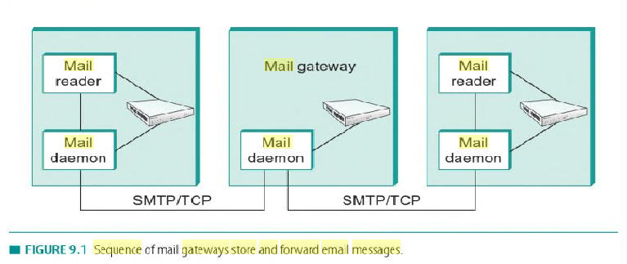
Message Transfer

Slide 15
Traditional Applications
Electronic Mail (SMTP, MIME, IMAP)
  Mail Reader
    The final step is for the user to actually retrieve his or her messages from the mailbox, read them, reply to them, and possibly save a copy for future reference.
    The user performs all these actions by interacting with a mail reader.
    mail reader was originally just a program running on the same machine as the user’s mailbox, in which case it could simply read and write the file that implements the mailbox.

Slide 16
Traditional Applications
Electronic Mail (SMTP, MIME, IMAP)
  Mail Reader
    In other cases, user accesses his mailbox from a remote machine using another protocol, such as the Post Office Protocol (POP) or the Internet Message Access Protocol (IMAP).

Slide 17
Traditional Applications
Electronic Mail (SMTP, MIME, IMAP)
  Mail Reader
    IMAP is similar to SMTP in many ways.
    It is a client/server protocol running over TCP, where the client (running on the user’s desktop machine) issues commands in the form of <CRLF> terminated ASCII text lines and the mail server (running on the machine that maintains the user’s mailbox) responds back to the client.
    The exchange begins with the client authenticating himself, and identifying the mailbox he wants to access.

Slide 18
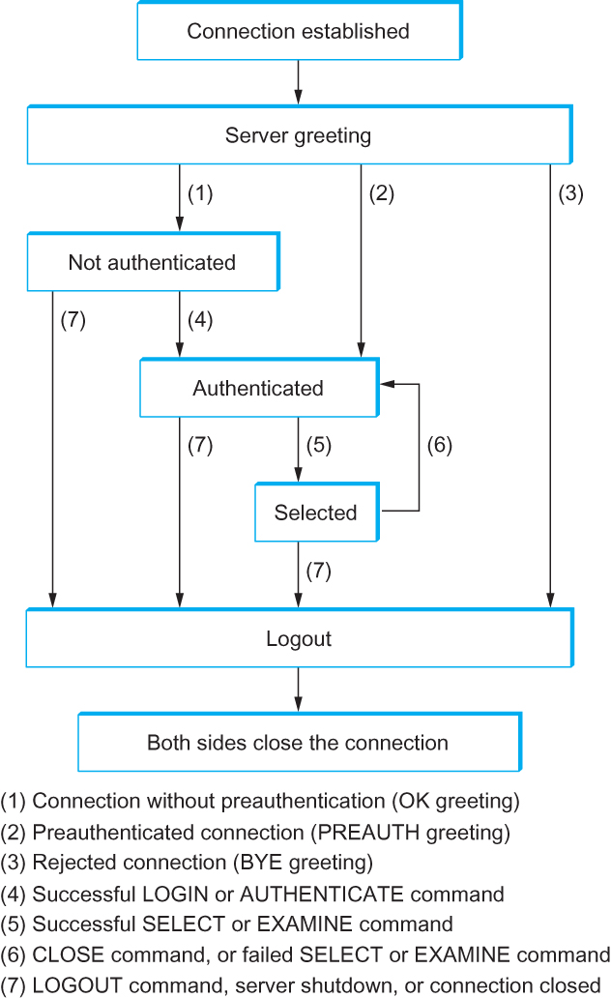
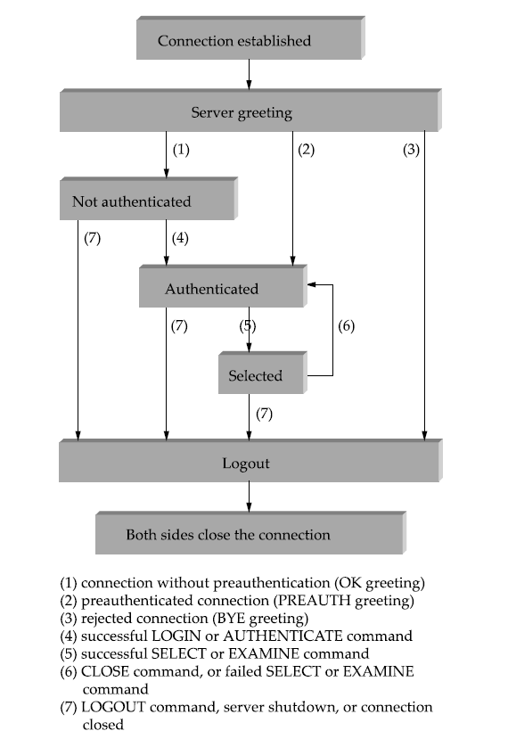
Traditional Applications
IMAP State Transition Diagram

Slide 19
IMAP state transition diagram
In the diagram, LOGIN, AUTHENTICATE,SELECT,EXAMINE,CLOSE and LOGOUT are example commands that the client can issue, while OK is considered as the server response.
When the user asks to fetch a message, the server returns it in MIME format and the mail reader decodes it.
IMAP also defines a set of message attributes that can be exchanged as part of commands.
Various flags are associated with the message such as Seen, Answered, Deleted and Recent. These flags are used to keep the client and server synchronized. ie,when the user deletes a message in the mail reader, the client needs to report this fact to the mail server.

Slide 20
Traditional Applications
World Wide Web (HTTP)
  The World Wide Web has been successful and made the Internet accessible to many people so that it seems to be synonymous with the Internet.
  The original goal of the Web was to find a method to organize and retrieve information, so that they found HTTP protocol to transfer the information in internet.

Slide 21
Traditional Applications
World Wide Web
  The core idea of hypertext is that one document can link to another document, and the protocol (HTTP) and document language (HTML) were designed to meet that goal.
  Web is considered as a set of cooperating clients and servers, which can communicate through HTTP.

Slide 22
Traditional Applications
World Wide Web
  Any Web browser has a function that allows the user to open a URL. (Uniform Resource Locator)
  URLs provide information about the location of objects on the Web, and they look like the following:
    http://www.cs.princeton.edu/index.html

Slide 23
Traditional Applications
World Wide Web
  If we opened that particular URL, then the Web browser would open a TCP connection to the Web server at a machine called www.cs.princeton.edu and immediately retrieve and display the file called index.html.
  Most files on the Web contain images and text and also have some other objects such as audio and video clips.
  They also include URLs that point to other files that may be located on other machines, which is the core of the “hypertext” part of HTTP and HTML.

Slide 24
Traditional Applications
World Wide Web
  When we select to view a page, the browser (client) fetches the page from the server using HTTP running over TCP.
  Like SMTP, HTTP is a text oriented protocol.
  At its core, HTTP is a request/response protocol, where every message has the general form
  START_LINE <CRLF>
  MESSAGE_HEADER <CRLF>
  <CRLF>
  MESSAGE_BODY <CRLF>
  where as before,<CRLF>stands for carriage-return-line-feed.
  The first line (START LINE) indicates whether this is a request message or a response message.

Slide 25
Traditional Applications
World Wide Web
  Request Messages
    The first line of an HTTP request message specifies three things:
    1. the operation to be performed.
    2. the Web page the operation should be performed on.
    3. the version of HTTP being used.
    HTTP defines some request operations such as WRITE operation (that allow a Web page to be posted on a server), GET operation (fetch the specified Web page) and HEAD operation (fetch status information about the specified Web page).

Slide 26
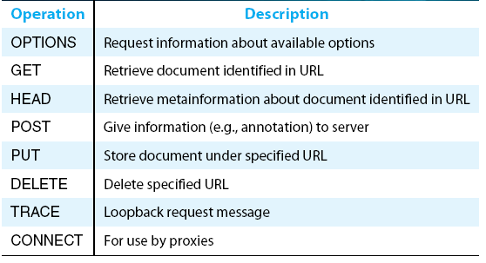
Traditional Applications
World Wide Web
  Request Messages
HTTP request operations

Slide 27
Traditional Applications
World Wide Web
  Response Messages
    Like request messages, response messages begin with a single START_ LINE.
    In this case, the line specifies the version of HTTP being used, a three-digit code indicating whether or not the request was successful, and a text string giving the reason for the response.
    For example, the START_LINE
    HTTP/1.1 202 Accepted (indicates that the server was able to satisfy the request. And
    HTTP/1.1 404 Not Found (indicates that it was not able to satisfy the request, because the web page was not found)

Slide 28
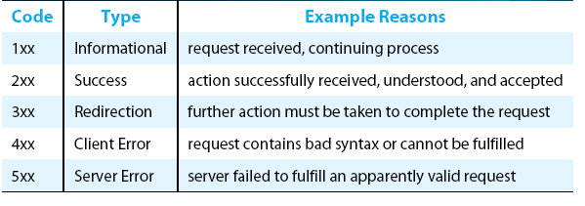
Traditional Applications
World Wide Web
  Response Messages
Five types of HTTP result codes

Slide 29
Traditional Applications
World Wide Web
  Uniform Resource Identifiers
    The URLs that HTTP uses as addresses are one type of Uniform Resource Identifier (URI).
    A URI is a character string that identifies a resource, where a resource can be anything that has identity, such as a document, an image, or a service.
    The first part of a URI is a scheme that names a particular way of identifying a certain kind of resource, such as mailto for email addresses or file for file names.
    The second part of a URI, separated from the first part by a colon, is the scheme-specific part.

Slide 30
Traditional Applications
World Wide Web
  TCP Connections
    The original version of HTTP (1.0) established a separate TCP connection for each data item retrieved from the server.
    It’s not too hard to see how this was a very inefficient mechanism: connection setup and teardown messages had to be exchanged between the client and server even if all the client wanted to do was verify that it had the most recent copy of a page.
    Thus, retrieving a page that included some text and a dozen icons or other small graphics would result in 13 separate TCP connections being established and closed.

Slide 31
Traditional Applications
World Wide Web
  TCP Connections
    To overcome this situation, HTTP version 1.1 introduced persistent connections— the client and server can exchange multiple request/response messages over the same TCP connection.
    Persistent connections have many advantages.
      First, they obviously eliminate the connection setup overhead, thereby reducing the load on the server, the load on the network caused by the additional TCP packets, and the delay perceived by the user.
      Second, because a client can send multiple request messages down a single TCP connection, TCP’s congestion window mechanism is able to operate more efficiently.
        This is because it’s not necessary to go through the slow start phase for each page.

Slide 32
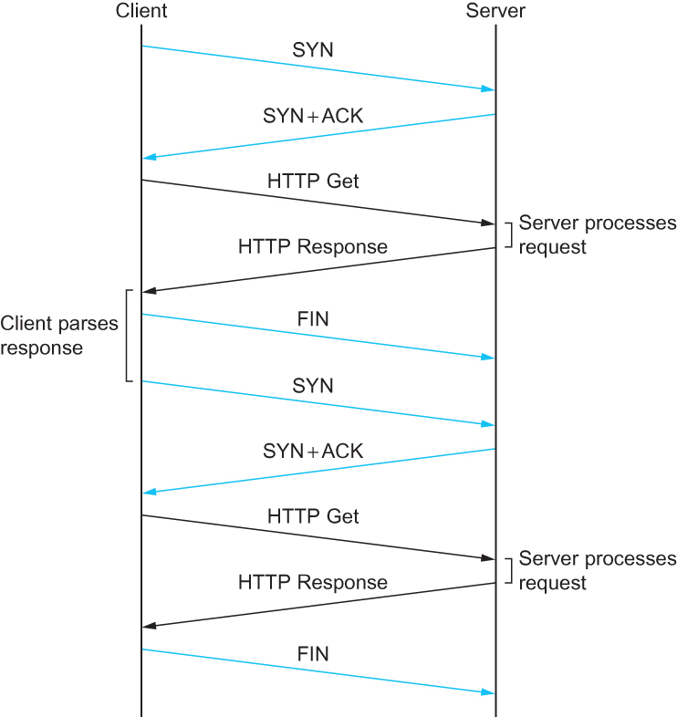
Traditional Applications
World Wide Web
  TCP Connections
HTTP 1.0 behavior

Slide 33
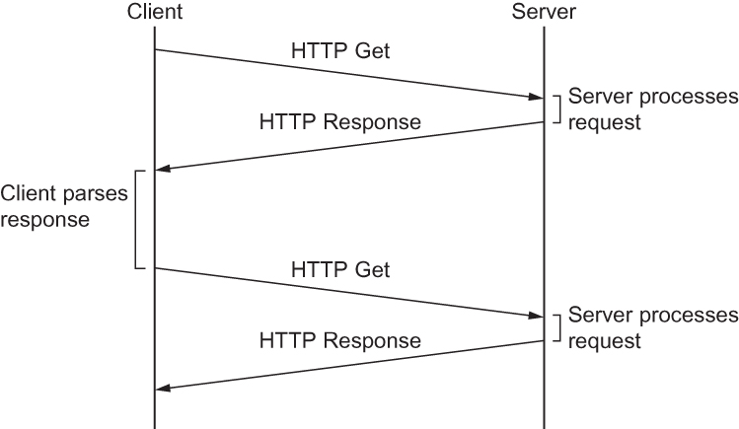
Traditional Applications
World Wide Web
  TCP Connections
HTTP 1.1 behavior with persistent connections

Slide 34
Traditional Applications
World Wide Web
  Caching
    One of the most active areas of research (and entrepreneurship) in the Internet today is how to effectively cache Web pages.
    Caching has many benefits. From the client’s perspective, a page that can be retrieved from a nearby cache can be displayed much more quickly than if it has to be fetched from across the world.
    From the server’s perspective, having a cache intercept and satisfy a request reduces the load on the server.

Slide 35
Traditional Applications
World Wide Web
  Caching
    Caching can be implemented in many different places. For example, a user’s browser can cache recently accessed pages, and simply display the cached copy if the user visits the same page again.
    As another example, a site can support a single site-wide cache.
    This allows users to take advantage of pages previously downloaded by other users.
    Closer to the middle of the Internet, ISPs can cache pages.
    Note that in the second case, the users within the site most likely know what machine is caching pages on behalf of the site, and they configure their browsers to connect directly to the caching host. This node is sometimes called a proxy

Slide 36
Name Service (DNS)
Domain Name System (DNS) is a name service used to translate host names into host addresses so that it allows the users of other applications to refer to remote hosts by name rather than by address.
  Host names differ from host addresses in two important ways.
    First, they are usually of variable length and mnemonic, thereby making them easier for humans to remember.
    Second, names typically contain no information that helps the network to locate the host.

Slide 37
Name Service (DNS)
Name Service (DNS)
  A namespace defines the set of possible names.
  - A name space can be either flat (names are not divisible into components), or it can be hierarchical (Unix file names are an example).
    naming system maintains a collection of bindings of names to values. The value can be anything we want the naming system to return when presented with a name; in many cases it is an address.
    A resolution mechanism is a procedure that, when invoked with a name, returns the corresponding value.
    A name server is a specific implementation of a resolution mechanism that is available on a network and that can be queried by sending it a message.

Slide 38
Name Service (DNS)
In Internet, a user presents a host name to an application program
( which is embedded in an email address or URL) and this program engages the naming system to translate this name into a host address.
The application then opens a connection to the host by presenting some transport protocol(eg.TCP) with the host’s IP address.This is illustrated in the following figure.

Slide 39
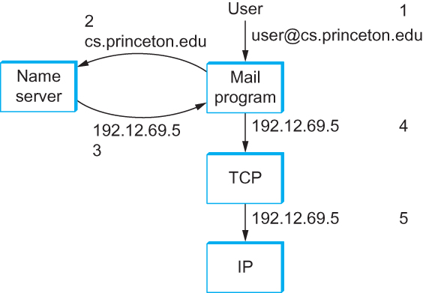
Name Service (DNS)
Name Service (DNS)
Fig: Names translated into addresses, where the numbers 1–5 show the sequence of steps in the process

Slide 40
Name Service (DNS)
Domain Hierarchy
  DNS implements a hierarchical name space for Internet objects.
  DNS names are processed from right to left and use periods as the separator.
  Eg) Domain name for a host is cicada.cs.princeton.edu.
  DNS maps domain names into values and these values are considered as IP addresses.
  DNS hierarchy can be visualized as a tree, where each node in the tree corresponds to a domain, and the leaves in the tree correspond to the hosts being named.

Slide 41
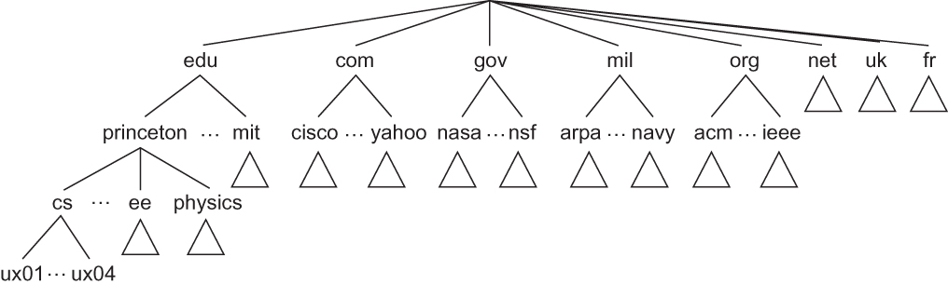
Name Service (DNS)
Domain Hierarchy
Fig : Example of a domain hierarchy

Slide 42
Name Service (DNS)
Name Servers
  The complete domain name hierarchy exists only in the abstract.
  DNS hierarchy can be partitioned into subtrees called zones.
  Each zone can be corresponding to some administrative authority that is responsible for that portion of the hierarchy.
  For example, the top level of the hierarchy forms a zone that is managed by the Internet Corporation for Assigned Names and Numbers (ICANN).
  Below this is a zone that corresponds to Princeton University.
  Within this zone,several departments will b there and so on.

Slide 43
Name Service (DNS)
Name Servers
  Name Server is the fundamental unit of implementation in DNS.
  The information contained in each zone is implemented in two or more name servers.
  Each name server is a program that can be accessed over the Internet.
  Client send queries to name servers, and name servers respond with the requested information.
  Each name server implements the zone information as a collection of resource records.
  a resource record is a name-to-value binding, or more specifically a 5-tuple that contains the following fields:
  <Name, Value, Type, Class, TTL >

Slide 44
Name Service (DNS)
Name Servers
  The Name and Value fields specify the exact name and its value, while the Type field specifies how the Value should be interpreted.
    For example, Type = A indicates that the Value is an IP address. Other types include NS,CNAME and MX.
    NS: The Value field gives the domain name for a host that is running a name server.
    CNAME: The Value field gives the canonical name for a particular host.
    MX: The Value field gives the domain name for a host that is running a mail
    server .
  The Class field allow entities to define useful record types.
  TTL field shows how long the resource record is valid.

Slide 45
Name Service (DNS)
Name Resolution
  Resolving a name actually involves a client querying the local server, which in turn acts as a client that queries the remote servers on the original client’s behalf.
  One advantage is that all the hosts in the internet do not have to be kept up to date on where the current root servers are located; instead only the servers have to know about the root.
  Another advantage is that the local server can see the answers that come back from queries that are posted by all the local clients.
  The local server caches these responses and used to resolve future queries.

Slide 46
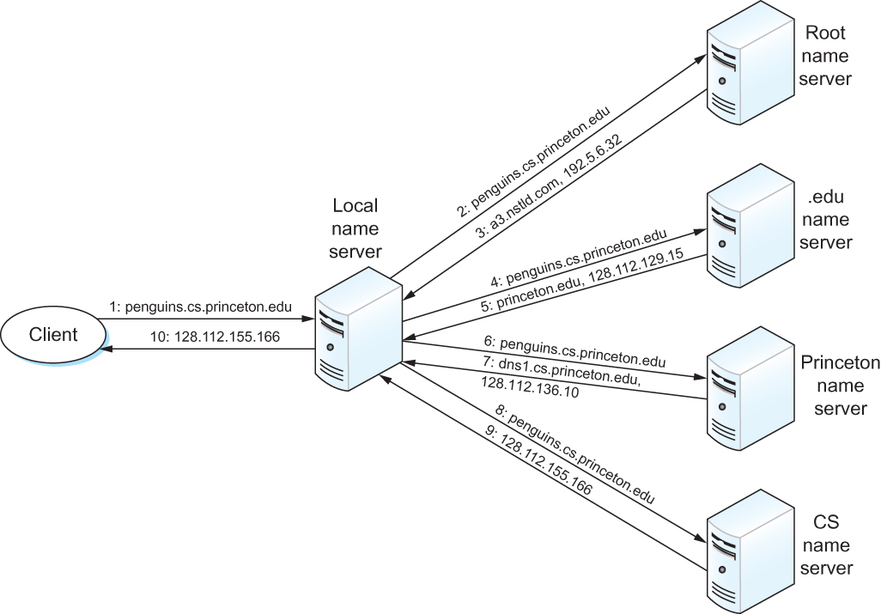
Name Service (DNS)
Name Resolution
Fig: Name resolution in practice, where the numbers 1–10 show the sequence of steps in the process.

Slide 47
Network Management
Network Management
  A network is a complex system, which includes a number of nodes and a set of protocols that can be running on each node.
  Network Management involves maintenance and manipulation of each nodes, managing address translation tables, routing tables,TCP connection states and so on.
  The most widely used protocol for Network Management is the Simple Network Management Protocol (SNMP).
  SNMP is a specialized request/reply protocol that supports two kinds of request messages: GET and SET.

Slide 48
Network Management
Network Management
  GET is used to retrieve a piece of state from some node, and SET is used to store a new piece of state in some node.
  SNMP is used in the obvious way.
    A system administrator interacts with a client program that displays information about the network.
    This client program usually has a graphical interface. This interface plays the same role as a web browser.
    Whenever the administrator selects a certain piece of information that he wants to see, the client program uses SNMP to request that information from the node in question. (SNMP runs on top of UDP.)
    An SNMP server running on that node receives the request, locates the appropriate piece of information, and returns it to the client program, which then displays it to the user.

Slide 49
Network Management
SNMP depends on a companion specification called the management information base(MIB).
MIB defines the specific pieces of information and the MIB variables that can retrieve from a network node.
The current version of MIB called MIB-II organizes variables into 10 different groups.
1. System : General parameters such as where the node is located and its name etc.
2. Interfaces : Information about all the network interfaces such as physical address of each interface, and how many packets can be send and received on each interface.
3. Address translation : Information about the address resolution protocol(ARP) and the contents of the address translation table.
4. IP : variables related to the IP, including its routing table, how many datagram it can forward and about the datagram reassembly.

Slide 50
Network Management
5. TCP: information about TCP connections such as the number of active and passive opens, the number of resets, number of timeouts and so on.
6. UDP: information about UDP traffic, including the total number of UDP datagrams that have been sent and received.
There are also groups for ICMP,EGP and SNMP itself.
The tenth group is used by different media.

Slide 51
Web Services
A Web service is a method of communication between two applications or electronic devices over the World Wide Web (WWW).
Web services are of two kinds: Simple Object Access Protocol (SOAP) and Representational State Transfer (REST).
Both architectures are individual applications that offers a remotely accessible service to client applications to form network applications.
SOAP defines a standard communication protocol (set of rules) specification for XML-based message exchange.
REST describes a set of architectural principles by which data can be transmitted over a standardized interface (such as HTTP).

Slide 52
Web Services
1.Custom Application Protocols(WSDL,SOAP)
SOAP architecture is based on Web services Description Language (WSDL)
SOAP and WSDL standards are issued by the World Wide Web Consortium (W3C).
WSDL and SOAP are frameworks for specifying and implementing application protocols and transport protocols respectively. They are generally used together.
WSDL is used to specify application-specific details such as what operations are supported, the formats of the application data to invoke or respond to those operations, and whether an operation involves a response.

Slide 53
Web Services
SOAP’s role is to make it easy to define a transport protocol with the desired semantics regarding the protocol features such as reliability and security.
Both WSDL and SOAP consist of a protocol specification language and both languages are based on XML.
1.1 Defining Application Protocols
WSDL have a procedural operation model of application protocols.
An operation is similar to a remotely callable procedure in an RPC system.
Eg) Consider a hotel reservation web service with two operations such as Check Availability and Make Reservation.

Slide 54
Web Services
Each operation specifies a message exchange pattern(MEP) that gives the sequence in which the messages are to be transmitted, including the fault messages to be sent when an error disrupts the message flow.
Mainly two MEPs are used such as,
In-Only ( a single message from client to service) and
In-Out ( a request from client and a corresponding reply from service).
Message formats in MEPs are defined as an abstract data model using XML schema.
XML schema provides a set of primitive data types and ways to define compound data types.
WSDL separates protocol as two parts : abstract and concrete.

Slide 55
Web Services
WSDL’s concrete part specifies an underlying protocol, how MEPs are mapped onto it, and what bit-level representation is used for messages. This part of specification is known as binding.
WSDL has predefined bindings for HTTP and SOAP based protocols.
WSDL allows multiple bindings for some web service.
An instance of an abstract web service could be accessible via multiple bindings, or there could be two instances of the same abstract web service that are accessible through two different bindings.
The WSDL specification of a web service may be composed of multiple WSDL documents and individual WSDL documents may also be used in other web service specifications.

Slide 56
Web Services
1.2 Defining Transport Protocols
SOAP can be considered as a framework for defining protocols.
SOAP provides a simple messaging framework whose core functionality is concerned with providing extensibility.
SOAP is used to define transport protocols with exactly the features needed to support a particular application protocol.
SOAP defines many protocols by using reusable components.
SOAP 1.2 introduced a feature abstraction.
A SOAP feature is an extension of the SOAP messaging framework. Example features may include “reliability”, “security”, “correlation”, “routing”, and message exchange patterns (MEPs) such as request/response, one-way and peer-to-peer conversations.

Slide 57
Web Services
A SOAP feature specification must include:
1. A URI that identifies the feature.
2. The state information and processing, that is required at each SOAP node to implement the feature.
3. The information to be relayed to the next node.
4. If the feature is a MEP, the life cycle and the relationships of the messages exchanged should be considered.
After specifying the feature, there are two strategies for defining a SOAP protocol.
They are layering and binding. Binding SOAP to an underlying protocol is to derive the features.

Slide 58
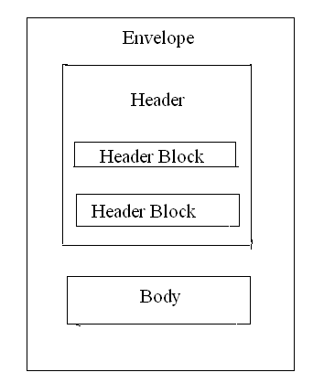
Web Services
A SOAP message consists of an envelope which contains header blocks, and a body that contains the payload destined for the ultimate receiver. The message structure is shown below.
Figure: SOAP message structure

Slide 59
Web Services
For a SOAP message,
A digital signature is used to implement authentication.
A sequence number is used for reliability.
Checksum is used to detect message corruption
A SOAP module is a specification of the syntax and the semantics of one or more header blocks. Each module provides one or more features and must declare the features it implements.
The goal behind SOAP module is to be able to compose a protocol with a set of features by including each of the corresponding module specifications.
Another important aspect of SOAP message is that a given message may be processed by not only a sender and a receiver, but also by SOAP-aware intermediary nodes.

Slide 60
Web Services
An intermediary SOAP node may modify a message before relaying it, like by adding or removing a header or by encrypting or decrypting the message.
SOAP prescribes how an intermediary node should process a given message. For that, each header block specifies one role.
A node should only process header blocks that specify a role assumed by the node.
1.3 Standardizing Web services protocols
WSDL and SOAP are not protocols, but they are standards for specifying protocols.
The standardization and customization is achieved by establishing partial standards called profiles.

Slide 61
Web Services
A profile is a set of guidelines that narrow or constrain choices available in WSDL,SOAP and other standards that may be referenced in defining a protocol.
The broadcast and more widely adopted profile is known as the WS-I Basic Profile. It was proposed by Web Services Interoperability Organization ( WS-I).
The WS-I Basic Security Profile adds security constraints to the Basic Profile by specifying how the SSL/TSL layer is to be used.
The Basic Profile and the Basic Security Profile are “horizontal” profiles, applicable across application domains.
Vertical Profiles are defined for specific domains,usually industries.

Slide 62
Web Services
2. A Generic Application Protocol (REST)
The WSDL/SOAP web services architecture is based on the assumption that the best way to integrate applications across networks is via protocols that are customized to each application.
REST web services architecture is based on the assumption that the best way to integrate applications across the networks is by applying the model underlying the World Wide Web architecture. This model is known as Representational State Transfer(REST).
In REST model, the complexity is shifted from the protocol to the payload. The payload is the representation of the abstract state of a resource. For example, a GET could return a representation of the current state of the resource, and a POST could send a representation of a desired state of the resource.

Slide 63
Web Services
2. A Generic Application Protocol (REST)
It is not necessary to transmit a complete resource state in each message. The size of messages can be reduced by transmitting just the parts of a state that are of interest.
Defining an application protocol in this architecture consists of defining the document structure.XML and the light-weight JavaScript Object Notation(JSON) are the most frequently used presentation languages.
In SOAP architecture, interoperability additionally depends on agreement on the protocol. Whereas in REST architecture, the protocol is always HTTP, so that source of interoperability problems is eliminated.
The Web and REST may also have an advantage in evolvability.

Slide 64
Overlay Network
In the last few years, the distinction between packet forwarding and application processing has become less clear.
New applications are being distributed across the Internet, and in many cases, these applications make their own forwarding decisions.
These new hybrid applications can sometimes be implemented by extending traditional routers and switches to support a modest amount of application-specific processing.
For example, so called level-7 switches sit in front of server clusters and forward HTTP requests to a specific server based on the requested URL.

Slide 65
Overlay Network
However, overlay networks are quickly emerging as the mechanism of choice for introducing new functionality into the Internet
overlay network can be considered as a logical network implemented on top of a some underlying network.
  By this definition, the Internet itself is an overlay network.
Each node in the overlay also exists in the underlying network; it processes and forwards packets in an application-specific way.
The links that connect the overlay nodes are implemented as tunnels through the underlying network.
Multiple-overlay networks can exist on top of the same underlying network – each implementing their own application-specific behavior.
Overlays can be nested, one on top of another.

Slide 66
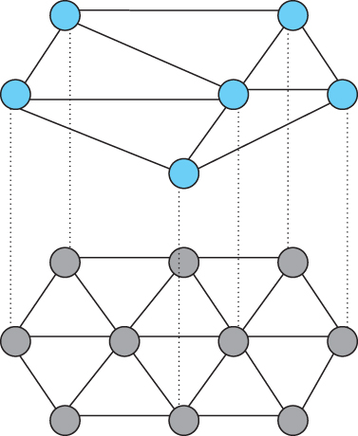
Overlay Network
Figure : Overlay network layered on top of a physical network

Slide 67
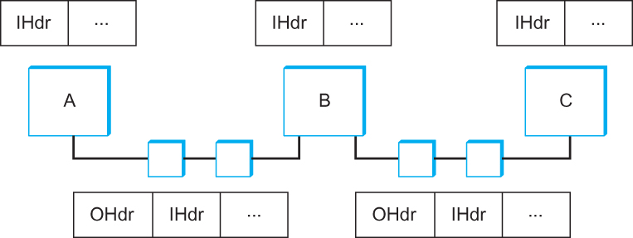
Overlay Network
Figure: Overlay nodes tunnel through physical nodes

Slide 68
Overlay Network
The above figure shows three overlay nodes (A,B and C) connected by a pair of tunnels. In this example, overlay node B might make a forwarding decision for packets from A to C based on the inner Header (IHdr), and then attach an outer header (OHdr) that identifies C as the destination in the underlying network.
Nodes A,B, and C are able to interpret both the inner and outer header, whereas the intermediate routers understand only the outer header.
Similarly, A, B, and C have addresses in both the overlay network and the underlying network, but they are not necessarily the same.
In fact, the overlay need not use conventional addresses, but may route based on URLs, domain names, an XML query, or even the content of the packet.

Slide 69
Overlay Network
Routing Overlays
  The simplest kind of overlay is one that exists purely to support an alternative routing strategy; no additional application-level processing is performed at the overlay nodes.
  Consider a virtual private network(VPN) as an example of a routing overlay.
  In this case, the overlay is said to use “IP tunnels”, and the ability to utilize these VPNs is supported in many commercial routers.

Slide 70
Overlay Network
Routing Overlays
  Suppose, we want to use a routing algorithm, then
    First, we could simply run the algorithm on a collection of end hosts, and tunnel through the Internet routers.
    These hosts would behave like routers in the overlay network: as hosts they are probably connected to the Internet by only one physical link, but as a node in the overlay they would be connected to multiple neighbors via tunnels.
Experimental Versions of IP
    Overlays are ideal for deploying experimental versions of IP.
    For example, IP multicast is an extension to IP that interprets class D addresses as multicast addresses.

Slide 71
Overlay Network
Routing Overlays
    The Mbone (multicast backbone) is an overlay network that implements IP multicast on top of the unicast routing provided by the Internet.
    One of the popular applications run on top of the Mbone is vic, a tool that supports multiparty videoconferencing.
    Vic is used to broadcast both seminars and meetings across the Internet.
    Mbone uses both IP tunnels and IP addresses and it implements a different forwarding algorithm- it forwards packets to all downstream neighbors in the shortest path multicast tree.

Slide 72
Overlay Network
Routing Overlays
  End System Multicast
    In response multicast-based applications like videoconferencing have recently turned to an alternative strategy, called end system multicast.
    The idea of end system multicast is to accept that IP multicast will never become ubiquitous, and to instead let the end hosts that are participating in a particular multicast-based application implement their own multicast trees.
    End system multicast assumes that only Internet hosts participate in the overlay. Moreover these hosts typically exchange messages with each other through UDP tunnels rather than IP tunnels, making it easy to implement as regular application programs.

Slide 73
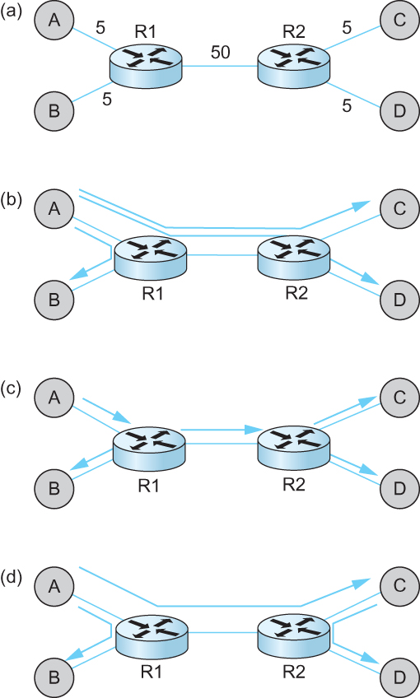
Overlay Network
Routing Overlays
  End System Multicast
(a) depicts an example physical topology, where R1 and R2 are routers connected by a low-bandwidth transcontinental link; A, B, C, and D are end hosts; and
link delays are given as edge weights. Assuming A wants to send a multicast message to the other three hosts,
(b) shows how naive unicast transmission would
work. This is clearly undesirable because the same message must traverse the link A–R1 three times, and two copies of the message traverse R1–R2.
(c) depicts the IP multicast tree constructed by DVMRP. Clearly, this approach eliminates the redundant
messages. Without support from the routers, however, the best one can hope for with end system multicast is a tree similar to the one shown in (d).
End system multicast defines an architecture for constructing this tree.

Slide 74
Overlay Network
Routing Overlays
  End System Multicast
    The general approach is to support multiple levels of overlay networks, each of which extracts a sub graph from the overlay below it, until we have selected the sub graph that the application expects.
    For end system multicast, this happens in two stages: first we construct a simple mesh overlay on top of the fully connected Internet, and then we select a multicast tree within this mesh.

Slide 75
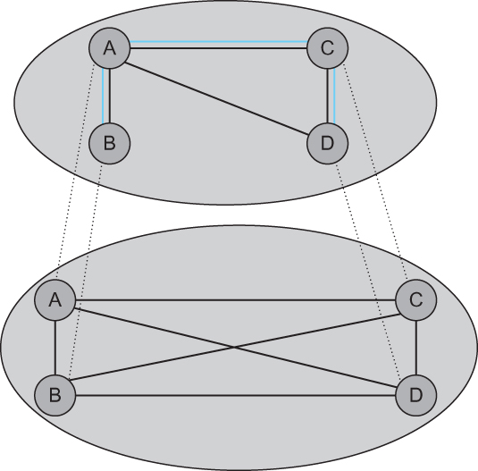
Overlay Network
Routing Overlays
  End System Multicast
Figure: Multicast tree embedded in an overlay mesh

Slide 76
Overlay Network
Resilient Overlay Networks(RON)
  Another function that can be performed by an overlay is to find alternative routes for traditional unicast applications.
  Such overlays exploit the observation that the triangle inequality does not hold in the Internet.
  RON scales to only a few dozen nodes because it uses an NxN strategy of closely monitoring three aspects of path quality such as latency, available bandwidth, and loss probability – between every pair of sites.
  RON is able to deliver modest performance improvements to applications, but it recovers from network failures much more quickly.
  The main feature of this overlay network is virtualization.
  ie, it is possible to build a virtual network from abstract resources on top of a physical network constructed from physical resources.

Slide 77
Overlay Network
Peer-to-peer Networks
  peer-to-peer network allows a community of users to pool their resources, thereby providing access to a larger archival store.
  peer-to-peer networks are said to be decentralized and self-organizing, Which means that individual nodes organize themselves into a network without any centralized coordination.
  In peer-to-peer networks, both the process of locating an object and the process of downloading that object into a local machine can happen without contact a centralized authority, and at the same time, the system is able to scale to millions of nodes.
  A peer-to-peer system that can accomplish these two tasks in a decentralized manner turns out to be an overlay network.

Slide 78
Overlay Network
Peer-to-peer Networks
  Gnutella
    Gnutella is an early peer-to-peer network that attempted to distinguish between exchanging music and the general sharing of files.
    Gnutella was one of the first such systems that not depend on a centralized registry of objects.
    Instead Gnutella participants arrange themselves into an overlay network.
    ie, each node that runs the Gnutella software knows about some set of other machines that also run the Gnutella software.
    Whenever the user on a given node wants to find an object, Gnutella sends a QUERY message for the object by specifying the file’s name to its neighbors in the graph.

Slide 79
Overlay Network
Peer-to-peer Networks
  Gnutella
    If one of the neighbors has the object, it responds to the node that sent it the query with a QUERY RESPONSE message, specifying where the object can be downloaded.
    That node can subsequently use GET or PUT messages to access the object.
    If the node cannot resolve the query, it forwards the QUERY message to each of its neighbors and the process repeats.
    ie, Gnutella floods the overlay to locate the desired object.
    Gnutella sets a TTL on each query so this flood does not continue indefinitely.

Slide 80
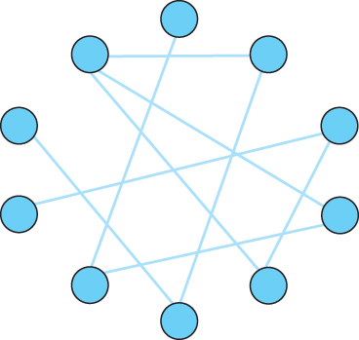
Overlay Network
Peer-to-peer Networks
  Gnutella
Example topology of a Gnutella peer-to-peer network

Slide 81
Overlay Network
Peer-to-peer Networks
  Structured Overlays
    Unstructured overlays like Gnutella employ trivial overlay construction and maintenance algorithms, but the best they can offer is unreliable, random search.
    In contrast, structured overlays are designed to conform to a particular graph structure that allows reliable and efficient object location, in return for additional complexity during overlay construction and maintenance.
    In structured overlays, we have to map objects into nodes and route a request to the node that is responsible for a given object.

Slide 82
Overlay Network
Peer-to-peer Networks
  Structured Overlays
    A well-known technique for mapping names into address is to use a hash table, so that
      hash(x) → n
    implies object x is first placed on node n, and at a later time, a client trying to locate x would only have to perform the hash of x to determine that it is on node n.
    A hash-based approach has the property that it tends to spread the objects evenly across the set of nodes.
    Suppose, there are101 possible hash values, then we use a modulo hash function; that is,
      hash(x)
      return x % 101.

Slide 83
Overlay Network
Peer-to-peer Networks
  Structured Overlays
    Structured peer-to-peer networks use an algorithm known as consistent hashing, which hashes a set of objects x uniformly across a large ID space.
    To place objects,
    hash(object_name) →objid
    To place nodes,
    hash(IP_addr)→ nodeid
    An alternative approach used by structured peer-to-peer networks is to route a message to this node. This approach is also called as distributed hash tables(DHT),since hash table is distributed over all the nodes in the network.

Slide 84
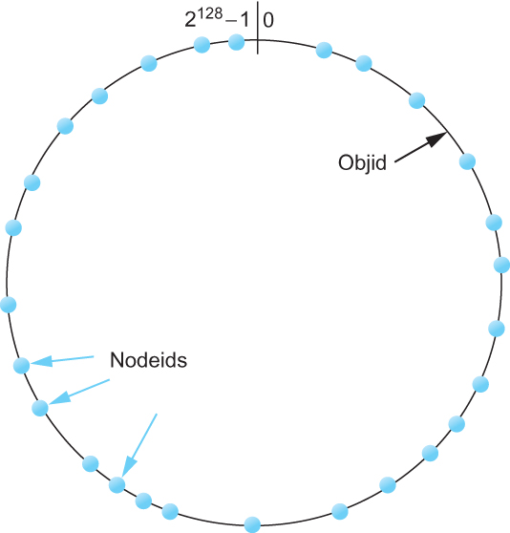
Overlay Network
Peer-to-peer Networks
  Structured Overlays
Both nodes and objects map (hash) onto the id space, where objects are maintained at the nearest node in this space.

Slide 85
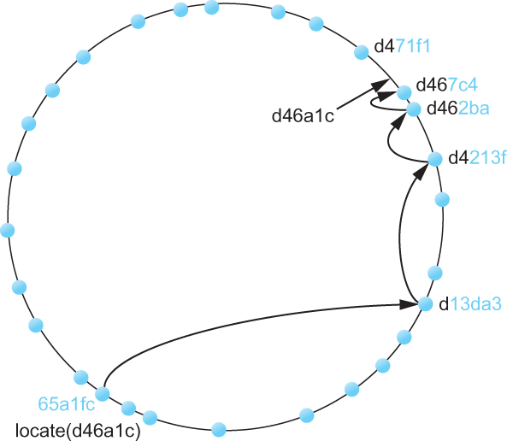
Overlay Network
Peer-to-peer Networks
  Structured Overlays
Objects are located by routing through the peer-to-peer overlay network.

Slide 86
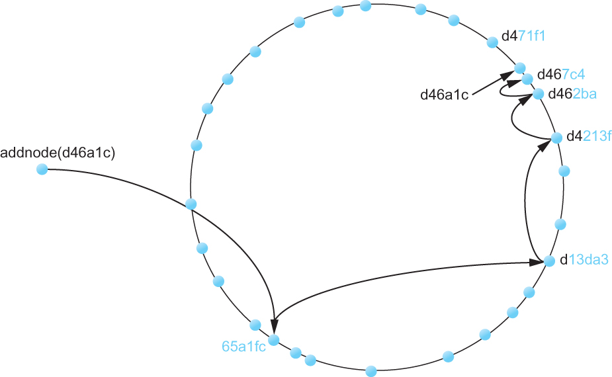
Overlay Network
Peer-to-peer Networks
  Structured Overlays
Adding a node to the network

Slide 87
Overlay Network
Peer-to-peer Networks
  BitTorrent
    BitTorrent is a peer-to-peer file sharing protocol devised by Bram Cohen.
    It is based on replicating the file, or rather, replicating segments of the file, which are called pieces.
    Any particular piece can usually be downloaded from multiple peers, even if only one peer has the entire file.
    The primary benefit of BitTorrent’s replication is avoiding the bottleneck of having only one source for a file. This is particularly useful when you consider that any given computer has a limited speed at which it can serve files over its uplink to the Internet, often quite a low limit due to the asymmetric nature of most broadband networks.

Slide 88
Overlay Network
Peer-to-peer Networks
  BitTorrent
    The main feature of BitTorrent is that replication is a natural side-effect of the downloading process: as soon as a peer downloads a particular piece, it becomes another source for that piece.
    The more peers downloading pieces of the file, the more piece replication occurs, distributing the load proportionately, and the more total bandwidth is available to share the file with others.
    Pieces are downloaded in random order to avoid a situation where peers find themselves lacking the same set of pieces.

Slide 89
Overlay Network
Peer-to-peer Networks
  BitTorrent
    Each file is shared via its own independent BitTorrent network, called a swarm.(A swarm could potentially share a set of files, but we describe the single file case for simplicity.)
    The lifecycle of a typical swarm is as follows. The swarm starts as a singleton peer with a complete copy of the file.
    A node that wants to download the file joins the swarm, becoming its second member, and begins downloading pieces of the file from the original peer.
    In doing so, it becomes another source for the pieces it has downloaded, even if it has not yet downloaded the entire file.

Slide 90
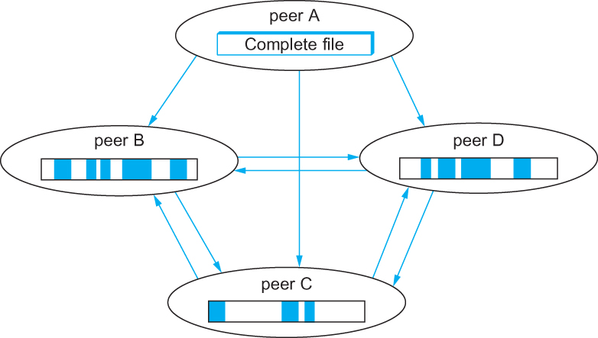
Overlay Network
Peer-to-peer Networks
  BitTorrent
Peers in a BitTorrent swarm download from other peers that may not yet have the complete file

